Slide 1
The Rule of Biomarker in Clinical Treatment of Tumors
慕 鹰
Ph.D., D.A.B.T., N.P.G.E.
30.7.2022
inClinicalTreatmentofTumors

Slide 2

Definition of Biomarker
A measurable indicator of some biological state or condition
Good biomarkers should exhibit good sensitivity (the fraction of correctly identified true positives) and good specificity (the fraction of correctly identified true negatives).
In medical biomarker studies it is becoming increasingly common to report this tradeoff in sensitivity and specificity using a Receiver Operating Characteristic (ROC) curve.^{[2]}
Notes:
湖南实验犬繁育及科研基地

Slide 3
The Global Market Size 2018-26 or 2030
CAGR of 12.1%
CAGR of 5.5%
CAGR of 8.9% CAGR of 8.5%
The biomarkers The generic drugs The drug discovery The preclinical CRO
The global biomarkers market size stood at USD 39.10 billion in 2018 and is projected to reach USD 97.51 billion by 2026, exhibiting a CAGR of 12.1%
Biomarkers Market Size Worth $147.59 Billion By 2028 | CAGR: 14.2%: Grand View Research, Inc.
The global generic drugs market size reached a value of almost USD 370 billion in the year 2020. The market is further expected to grow at a CAGR of 5.5% between 2021 and 2026 to reach a value of almost USD 510.2 billion by 2026
The global drug discovery market size was valued at US$ 74.96 billion in 2021 and is expected to be worth around US$ 161.76 billion by 2030, growing at a CAGR of 8.9% from 2021 to 2030
The preclinical CRO market size is expected to garner around US$ 8.9 billion by 2030 and is projected to grow at a CAGR of 8.5% from 2021 to 2030.
The global small molecule innovator CDMO market size was valued at USD 41.1 billion in 2020, and is predicted to be worth around USD 73.9 billion by 2030, registering a CAGR of 6.4% during the forecast period 2022 to 2030.
Notes:
湖南实验犬繁育及科研基地

Slide 4
"Guiding Light" Biomarkers for Drug R&D
How to select subjects and evaluate their response to drugs is a major challenge in the development of innovative drugs, and biomarkers are an effective means to address this challenge e.g. the preselection of drug-specific sensitive population, personalized medicines, longevity, etc.
By analyzing the failures of Phase II and Phase III clinical trials from 2013 to 2015, the researchers found that poor efficacy and safety issues accounted for 73% of all Phase II clinical trial failures, and were also the most unsuccessful Phase III clinical trials main reason. The first of the authors' improvements to improve the success rate of clinical trials is to use more effective biomarkers

Slide 5
Category
Product
Consumables
Services
Software
Type
Safety Biomarkers
Efficacy Biomarkers
Predictive Biomarkers
Surrogate Biomarkers
Pharmacodynamics Biomarkers
Prognostic Biomarkers
Validation Biomarkers
Application
Diagnostics
Drug Discovery & Development
Personalized Medicine
Disease Risk Assessment
Other Applications
Other Disease Indications
.

Slide 6
Long Non-coding RNA Biomarker For Human Laryngeal Squamous Cell Carcinoma Prognosis
Long non-coding RNAs (lncRNA) were discovered in tumors
The surgical resected LSCC tissues, adjacent non-cancerous tissues (ANCT) and lymph node metastatic tissue (LNM) were collected from 76 patients for lncRNA AC008440.10 expression assay.
The stages of LSCC and LNM were classified accordingly. We integrated the epigenetic information with enhanced CT imaging and pathological evaluations to predict the patients' survival by comprehensive statistical algorithms using equal weighting.
Significant downregulation of lncRNA AC008440.10 was detected in LSCC tumor and metastatic lymph node in advanced stage of patient samples compared with those in early stage. The pattern of differentially expressed AC008440.10 displayed a clear trend that significantly related to tumor progression.
The downregulation of lncRNA AC008440.10 correlates with increasing risk of metastasis, poor prognosis and patient survival.
The potential for lncRNA AC008440.10 to be developed as a novel biomarker for stratification of the prognosis was especially promising when clinic parameters were hybridized with equal weight, and using a panel of complementary parameters yielded a more powerful predictability of LSCC prognosis than any single parameter individually
Notes:
湖南实验犬繁育及科研基地

Slide 7
The primer sequence of AC008440.10
5′-CTGAGACCTCCCTCCCCTATG-3′ Forward
5′-GGGGTTGGGTAGAGGAAGGTA-3′ Reverse

Slide 8
Notes:
湖南实验犬繁育及科研基地

Slide 9
Summary
The downregulation of lncRNA AC008440.10 and tumor progression was inversely related and predicted poorer clinical prognosis
The AC008440.10 profile was significantly involved in tumor progression and metastasis by reflecting the survival rate
As clinically relevant indicator of tumor stages and patients' survival biomarker, lncRNA AC008440.10 demonstrated reliable predictability
It revealed a new opportunity in lncRNA based liquid biopsies for monitoring the progression of LSCC in clinic.
To strengthen the confidence of clinical decision making, we believe that the expression pattern of AC008440.10 can be integrated into a prognostic panel such as the combination of AC008440.10 profiling with CT imaging of drain lymph nodes. Our approach uncovered the fact that lncRNA AC008440.10 was associated with LSCC progression and patient survival
We propose the combination of lncRNA AC008440.10 with CT imaging can be more reliable for predicting prognosis than when either was applied individually

Slide 10
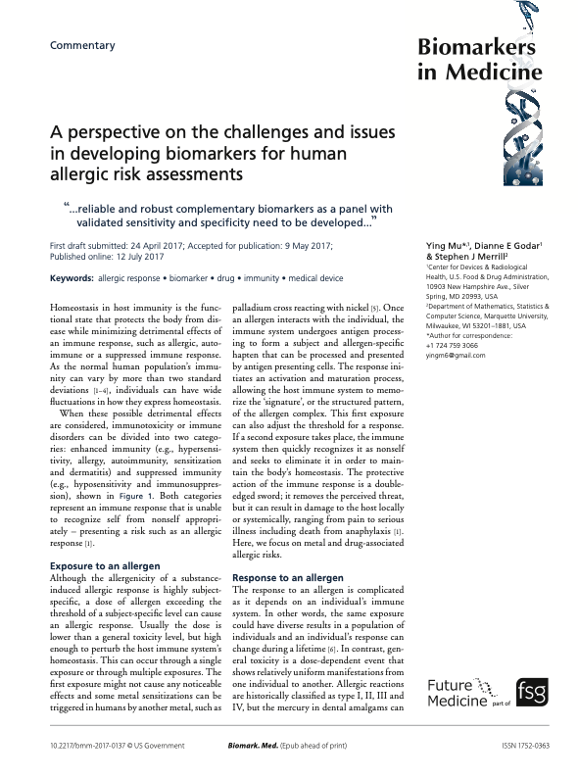

Slide 11
What’s the Best Protection of IPs?
Patents
Trademarks
Copyrights, and
Trade secrets (two critical conditions):
the info restriction
reverse engineering
are the 4 types of intellectual property

Slide 12
Q&A
CSO
ZSHK Lab.
Contact: muying@anlingbio.com
Cell: 96872258
Wechat:ying2256
WhatsApp: 96872258

