Slide 1
The Problems with Trade Secret Overprotection in Asia and How to Fix Them
Prof. Dr. Kung-Chung Liu, Singapore Management University/Renmin University of China/National Chengchi University, Taiwan/Adjunct Chair Professor Shandong University, China/Visiting Professor, National Law University Delhi

Slide 2
1. The problems associated with trade secret protection
1.1. Trade secret does not really belong to the IP family, although it is worth protecting
1.2. Trade secret is capricious and arbitrary in nature
1.3. Trade secret protection lessens positive externality
1.4. Trade secret protection indirectly prevents public oversight
1.5. Trade secret protection used to circumvent freedom of government information law

Slide 3
2. The over-protection of trade secret
2.1. Overly harsh criminal punishment for trade secret infringement, harsher than punishment for willful trademark counterfeiting and copyright piracy on a commercial scale,
or
2.2. Encroaching the principle of equality of arms among parties

Slide 4
3. Many side-effects of over-protection
3.1. Trade-off with patent regime
3.2. Crippling basic principles of rule of law
3.2.1. The principle of open court
3.2.2.The principle of transparency and
accountability
3.3. Stifling market competition (FRAND terms as trade secrets?)
3.4. Overly restraining employees’ mobility (sham trade secret to smear former employees by deep-pocketed employers)

Slide 5
The doctrinal origins of trade secret protection in common law and civil law countries differ
In Commonwealth common law countries, excluding the US, it is based on the breach of confidence, which is part of the law of equity, and protects many kinds of confidential information apart from trade secrets.
In civil law jurisdictions, it is based more on unfair competition law.
The US enacts sui generis statutory TS laws which are very harsh and absolute and exports the regime to its major Asian trading partners

Slide 6
Asian Jurisdictions: Different Approaches
With penal sanctions
1. with distinction between domestic and foreign crime:
Japan, Korea, Taiwan, and China
2. with no distinction between domestic and foreign
crime: The Philippines, Thailand, Vietnam
Without penal sanctions: HK, India, Singapore, Malaysia, Myanmar.

Slide 7
4. The over-protection of trade secrets in Asian economies
4.1. Some propertize trade secret
4.2. Some harshly criminalize trade secret Infringement
4.3. Some penalize economic espionage
4.4. Some follow “technical nationalism” to protect “national core technology”

Slide 8
4.1. Some propertize trade secret
China: Article 123(2) Civil Code recognizes trade secret as IP right which is a private right
Taiwan and Thailand follow the US approach in enacting sui-generis trade secret protection law.
A sui-generis trade secret protection law has the propensity of propertizing trade secrets, rather than being purely a means of behavioural or relational regulation.

Slide 9
4.2. Some harshly criminalize trade secret infringement
Major civil law jurisdictions in Asia are following the US in criminalizing trade secret infringement, with imprisonment of up to ten years in Japan, China, and Korea, up to five years in Taiwan (up to one year in Thailand).
In contrast, Germany provides a modest criminal punishment for trade secret infringement: two to three year imprisonment or alternatively a fine (Trade Secret Protection Act 2019)
They generally lack an effective civil discovery process, which will incentivize undue criminal cases to prosecute trade secret infringement.

Slide 10
4.3. Some penalize economic espionage
Following the US, Japan punishes economic espionage as well, ten-year imprisonment and increased fine.
Korea has been increasing the criminal punishment for economic espionage over the last decade. Currently, the maximum punishment is fifteen year imprisonment or a fine.
Taiwan doubles the criminal punishment for economic espionage, namely infringing a trade secret for the purpose of using it in foreign jurisdictions, Mainland China, Hong Kong, or Macau: imprisonment between one year and ten years, and a fine between NT$3 million and NT$50 million.
China, partially driven by the domestic need to deal with the rising issue of cross border economic espionage, from 2021 onwards punishes economic espionage with imprisonment from five years to fifteen years
Germany foresee 5 year impriosnment

Slide 11
However, criminal punishment is not often applied by courts
However, in practice criminal punishment is not often applied by courts.
In the US, despite the every-now-and-then news reports about high-profile arrests of alleged economic espionage, there are few actual charges and cases
According to PRO IP Act Annual Report FY 2019 ( no 2020 update)), Out of 64 IP-related criminal charges
Economic espionage, 18 U.S.C. § 1831 2 3%
Theft of trade secrets, 18 U.S.C. § 1832 14 22%

Slide 12
punishing economic espionage is placebo at best or a scapegoat at worst
The same is true for Japan, Korea and Taiwan.
In Japan, there has never been even one convicted economic espionage case by the end of 2020. Cases involving unknown persons who used improper means to acquire information are far rarer — only two of 30 cases.
As of June 2022, there has been only three finalized convictions of economic espionage in Taiwan, but all with probation.
In Korea, the maximum sentence for economic espionage is 12 months between 2017 and 2019, which is similar to or even lower than domestic infringement.

Slide 13
4.4. Some follow “technical nationalism” to protect “national core technology”
Korea: Act of Prevention of Divulgence and Protection of Industrial Technology of 2011 (2019 last amended)
to prevent undue divulgence of industrial technology and protect industrial technology in order to strengthen the competitiveness of Korean industries and contribute to national security and development of the national economy.
The Industrial Technology Protection Committee ( the "Committee") under the Prime Minister's Office chaied by the Prime Minister to deliberate on matters concerning the prevention of divulgence of industrial technology and protection of industrial technology.
Where an institution possessing industrial technology which holds national core technology developed with government subsidies for research and development intends to export the national core technology it shall obtain approval from the Minister of Knowledge Economy

Slide 14
Criminal punishment
Exporting national core technology without obtaining approval
Conducting cross-border acquisition, merger, etc. without obtaining approval
Conducting cross-border acquisition, merger, etc. without filing a report
Failing to comply with an order issued by the Minister of Trade, Industry and Energy
Using or disclosing information including industrial technology provided through any legitimate process prescribed by Presidential Decree, such as litigation on industrial technology, for any purpose other than the purpose for which such information was provided (Article 14, subparagraphs 5-8)
with intent to use industrial technology in a foreign country or to cause industrial technology to be used in a foreign country shall be punished by imprisonment with labor for not more than 15 years or by a fine not exceeding 1.5 billion won. (Art. 36(2))

Slide 15
Taiwan even resorts to National Security Act in 2022
No one shall commit any of the following acts for foreign countries, mainland China, HK, Macau, or hostile foreign powers and organizations, institutions, groups set up or substantially control controlled by them：
1. to acquire trade secrets of national core technologies through misappropriation, or to use or leak them out after acquiring them
2. to reproduce, use or leak out trade secrets of national core technologies that they know of or possess
3. not to delete or destroy trade secrets of national core technologies in their possession despite being requested by owners of the trade secrets
4. to acquire, use or leak out trade secrets of national core technologies in others’ possession, knowing that the trade secrets are those listed in the preceding three sub-paragraphs.
No one shall commit any of the acts lists in the preceding subparagraphs with the intension of using trade secrets of national core technologies in foreign countries, mainland China, HK, Macau (Art. 3)

Slide 16
National core technologies
National core technologies mean those once flown to foreign countries, mainland China, HK, Macau, or hostile foreign powers will severely damage national security, industrial competitiveness or economic development, mandated by one of the following conditions, announced by the Executive Yuan and notified to the Legislative Yuan:
1 International treaties, the needs of national defense, and the protection of key national infrastructure warrant regulation, or
2. the generation of leading technology or the major enhancement of industrial competitiveness
The National Science Council shall be in charge of promulgating provisions for the identification procedures
National core technologies once identified shall be subject to periodic review

Slide 17
Criminal punishment
Any violation of Art. 3(1) is subject to imprisonment up to 12 years and a fine btw NT$5 million and 100 million
Any violation of Art. 3(2) is subject to imprisonment btwn 3-10 years and a fine btw NT$5 million and 50 million
Any attempt of the preceding two violations is equally punishable
If the illicit gains of the violation exceed the maximum amount of the fine, the fine can be increased to 2- 10 times of the illicit gains. (Art. 8(1)-(4)

Slide 18
5. Fixing the problems
5.1. To base trade secret protection on its commercial realities:
small and medium sized (SME) business-based economies.
SME-based economies thrive on free flow of talents and vibrant start-ups.
net importer of innovative technology, with the exception of Japan

Slide 19
5.2. To work trade secret protection in tandem with patent regime
On a micro level, a good combination of patents and trade secrets is imperative for assets management.
Take TSMC for example, it protects roughly only 10% of its technical creations through patenting, the rest 90% via trade secret.
In 2018, more than 8,800 trade secrets were registered with Trade Secret Registration and Management System by TSMC. In comparison, TSMC filed 944 patent applications with Taiwan IP Office.

Slide 20
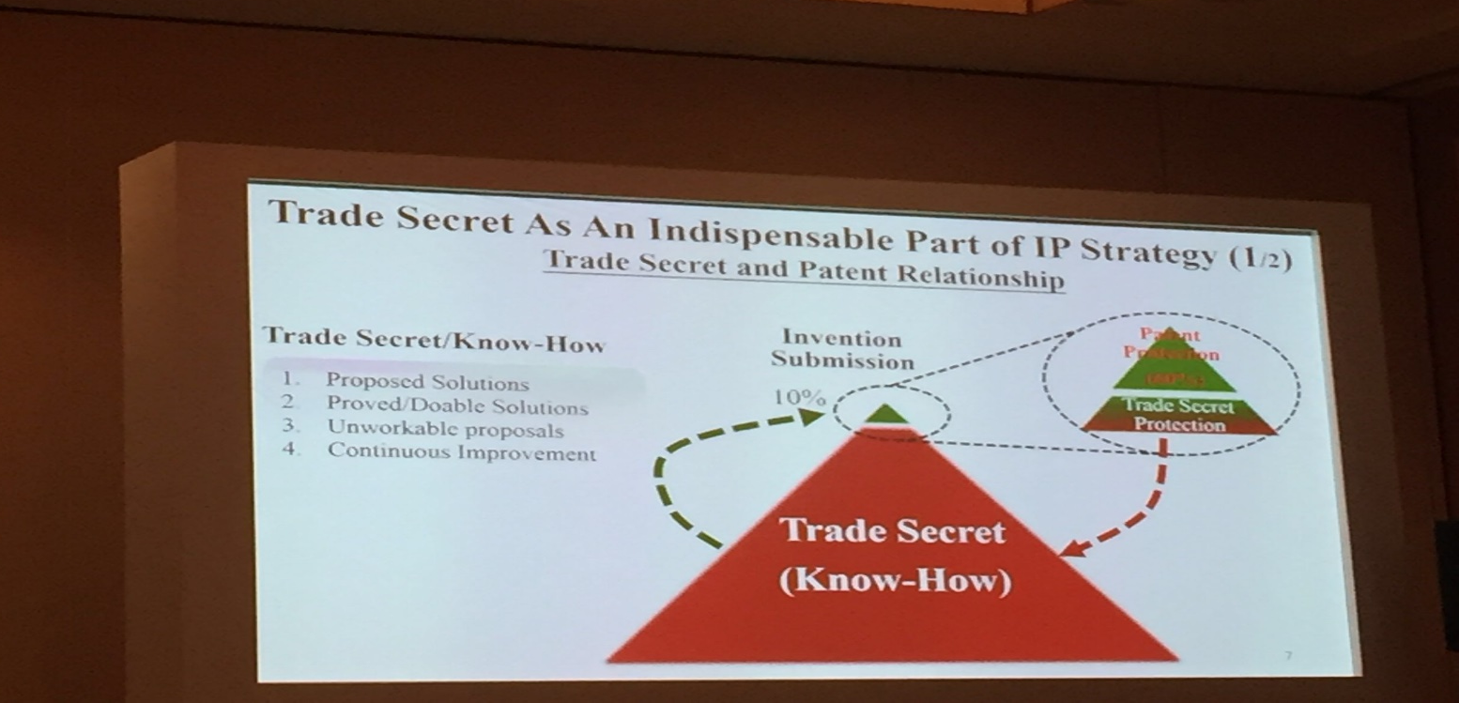
Small number of patents can cover large volume of trade secrets

Slide 21
5.2. To work trade secret protection in tandem with patent regime
On a macro level, the number of patent applications filed by and patents acquired by German industries have been very stable, with application ranging from 67,907 in 2016 to 62, 105 in 2020 and granted patents ranging from 18,255 in 2016 to 17,305 in 2020 respectively.
There is no hype for patenting in Germany, very different from China (1,344,817 filings and 440,691 granted invention patents in 2020)

Slide 22
5.3. No to technical nationalism!
Simply not feasible!
Its application can only be arbitrary
Violating the national treatment principle of the WTO with regards to other WTO members

Slide 23
5.4. To learn from Germany
According to the United Nations Industrial Development Organization, Germany ranked again the first amongst 152 countries in the Competitive Industrial Performance (CIP) Index 2020, a record it keeps since 2001
Germany is also an SME (with employee less than 250)-driven economy. In 2015, 99.6% of German firms were SMEs
Germany has 1,307 hidden champions, whereas the US has 366 and Japan 220

Slide 24
German model
German legal regimes have successfully balanced the protection of trade secret with the protection of employees’ freedom to work and at the same time upheld the proportionality between punishment and crime.
As a result, Germany has been ranked as world number 1 in terms of trade secret protection by the US Chamber of Commerce in its International IP Index from 2017 to 2021.

Slide 25
To restrain the use of criminal procedure
In Germany, criminal punishment has been rarely employed and therefore without much significance in practice.
Therefore, there shall be no criminal procedure if no public interests are involved.
Criminal procedures shall be suspended to wait for the results of civil procedure.
Not the other around.

Slide 26
To regulate non-competition clauses
German Commercial Code (Handelsgesetzbuch) protects the interests of employees’ mobility by limiting the non-competition clause:
two years at most and
withpayment of half of the last received salary

